Slide 1

Preparing an Infection Prevention and Control
Risk Assessment
Dianne Bourque, RN, CNOR
Board of Directors, QUAD A
Investigations Co-Chair
WWW .QUADA.ORG P A TIENTS FIRST. AL W A YS.

Slide 2
Objectives
Describe how to conduct an ICRA
Understand how to develop measurable IPC program goals
Explain when the ICRA should be reviewed/updated
WWW.QUADA.ORG PATIENTS FIRST. ALWAYS.

Slide 3

Infection (Prevention and) Control Risk Assessment
The Infection Control Plan (ICRA) serves as the foundation of the Infection Prevention and Control Plan.
Enables identification of high-risk priorities and areas for improvement
Regulatory requirement for Ambulatory Surgery Centers
WWW.QUADA.ORG PATIENTS FIRST. ALWAYS.

Slide 4
Infection (Prevention and) Control Risk Assessment
A multi-disciplinary approach is highly recommended
  Medical & Nursing Staff, Allied Health
  Leadership (for allotment of adequate time and resources)
Creating the ICRA for the first time is the most labor-intensive
In subsequent years, some values will remain the same; others will change only slightly
WWW.QUADA.ORG PATIENTS FIRST. ALWAYS.

Slide 5
ICRA - When and Why?
The ICRA should be performed at least annually, and all revisions must be informed by data
A risk assessment should also be considered when the facility is impacted by any major changes that may pose additional risks to patients, guests, or staff
  Invasive repairs or new construction
  Additional service lines
  New procedures
  Compelling infection issues (e.g., worrisome SSI rate)
WWW.QUADA.ORG PATIENTS FIRST. ALWAYS.

Slide 6
What Might be Considered in the ICRA?
Use findings from rounds, occurrence reports, surveillance data, and population risk assessments
  Community (rural/urban) and Population Served
  Facility, Utilities, and Waste, Linen, and Water Management
  Procedures and Services (and related considerations, specific to the type of procedure or medications, equipment needed)
  Staff Education and Competency
  Occupational Health (Health Questionnaire, Vaccinations, TB Testing)
  IPC Practices (Hand Hygiene, Use of PPE, Injection or Medication Safety, Environmental Cleaning )
  Patient Care Devices (Reprocessing, Storage)
  Multi-Drug Resistant Organism (MDRO) related Healthcare-Associated Infection (HAI)
  Disease Reporting, Surgical-Site Infection Rates
  Compliance Concerns (gathered from audits, monitoring)
WWW.QUADA.ORG PATIENTS FIRST. ALWAYS.

Slide 7
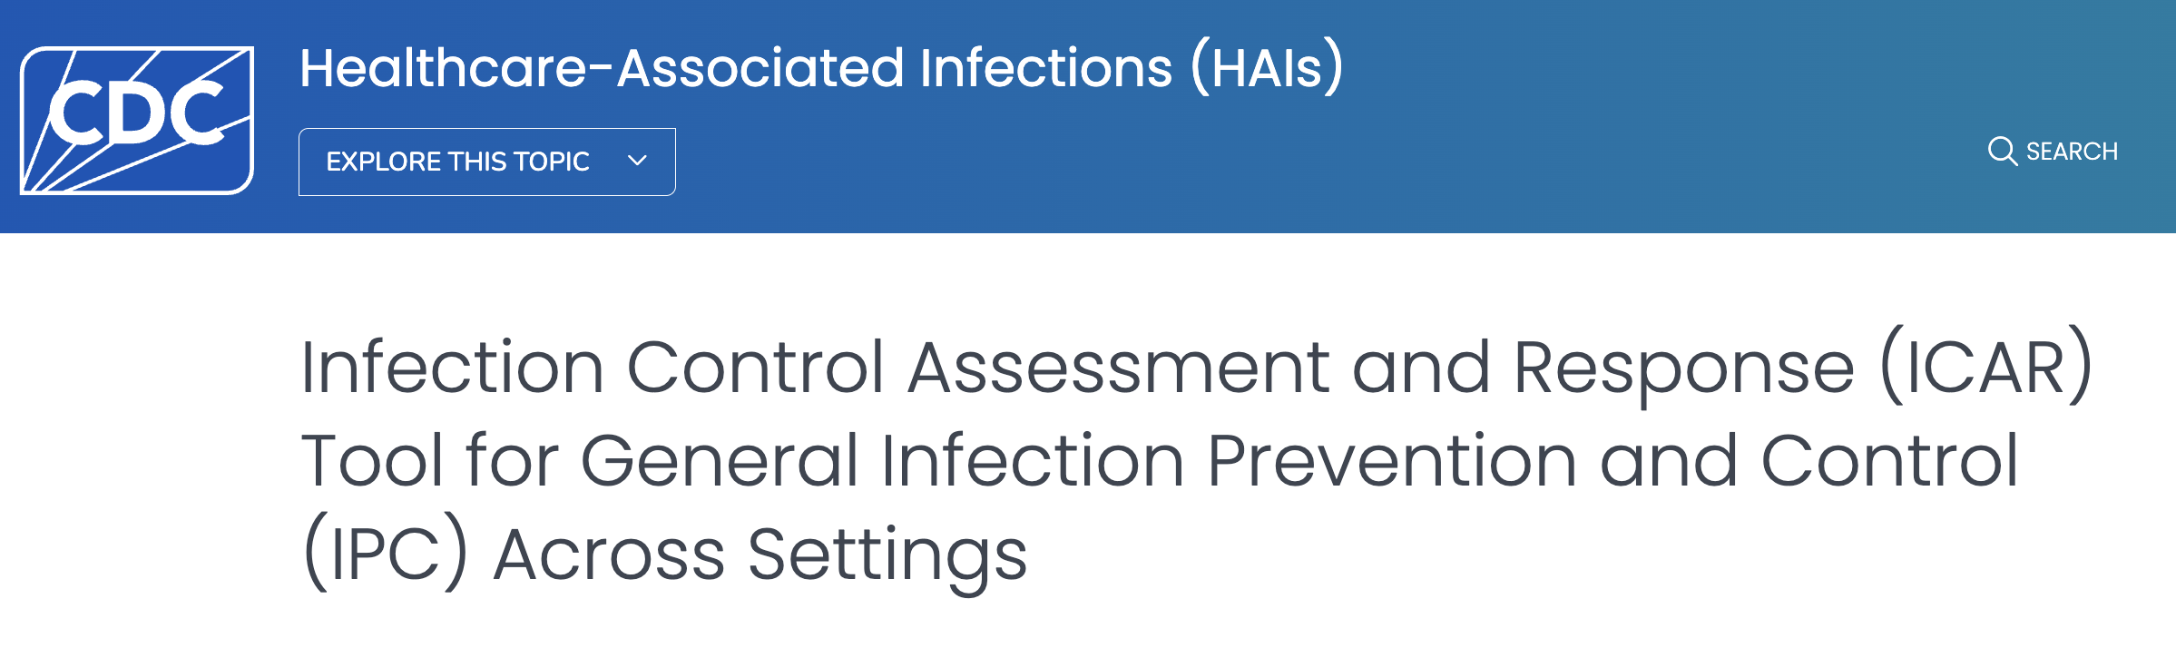
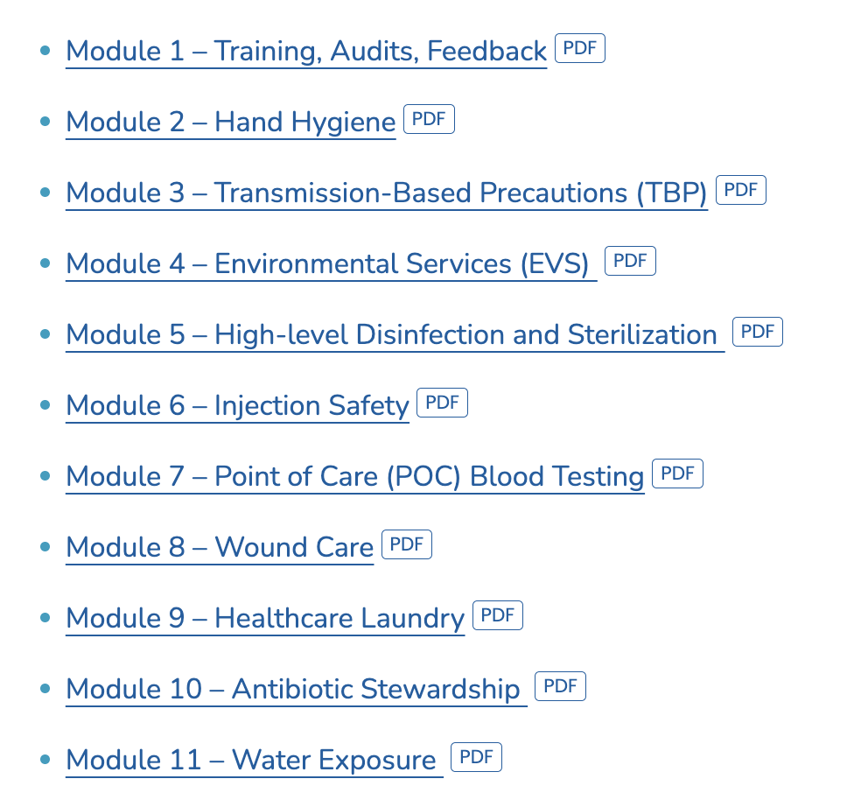
IC Assessment and Response (ICAR)
Tools from the CDC
WWW.QUADA.ORG PATIENTS FIRST. ALWAYS.

Slide 8
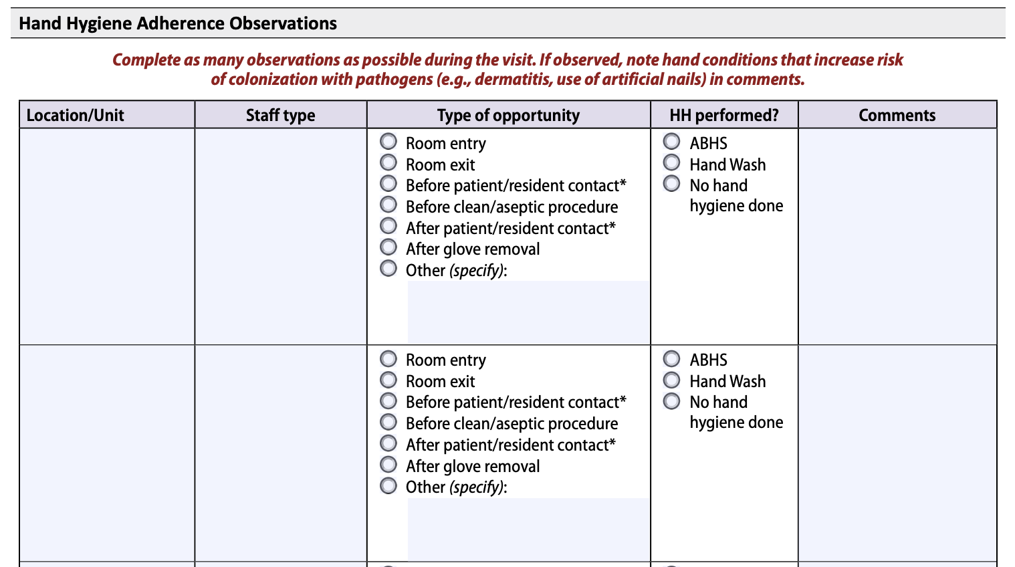
IC Assessment and Response (ICAR)
Tools from the CDC
WWW.QUADA.ORG PATIENTS FIRST. ALWAYS.

Slide 9
What Items Should Be Included in the ICRA?
Potential Events and Failures:
  What will happen if…?
  When possible, written in the negative (e.g., “lack of”)
    Poor Hand Hygiene Compliance
    Improper High-Level Disinfection or Sterilization of Medical Devices
Any historical problems presenting a known high-risk
  Flu season
  High SSI rate
All should be scored on three domains
  Probability, Impact, Preparedness
WWW.QUADA.ORG PATIENTS FIRST. ALWAYS.

Slide 10
Determining Probability
Probability of Occurrence
Use findings from rounds, occurrence reports, surveillance data, and population risk assessments
How likely is the event or failure to occur?
  Likely (3)*
  Maybe (2)
  Rare (1)
  Never (0)
The value assignment is determined to help you calculate risk, thus may be different from organization to organization
WWW.QUADA.ORG PATIENTS FIRST. ALWAYS.

Slide 11
Determining Impact
Risk of Impact to Patients
What is the worst-case scenario should the event/failure occur?
  Life-Threatening to the Patient (4)*
  Threat of Producing Permanent Harm to the Patient (3)
  Threat of Producing a Temporary Harm to the Patient (2)
  No Threat of Harm to the Patient (1)
The value assignment is determined to help you calculate risk, thus may be different from organization to organization
WWW.QUADA.ORG PATIENTS FIRST. ALWAYS.

Slide 12
Determining Preparedness
Facility Preparedness to Respond
How ready is the facility to respond if the event/failure does occur?
  Not Prepared to Respond (4)*
  Poorly Prepared to Respond (3)
  Fairly Prepared to Respond (2)
  Response Preparedness is Good (1)
The value assignment is determined to help you calculate risk, thus may be different from organization to organization
WWW.QUADA.ORG PATIENTS FIRST. ALWAYS.

Slide 13
Appropriate Scoring
Scores should be based on the level of harm that may occur if the event happened, not the potential for harm in the facility
Probability of occurrence scores should never be zero
  If there is no chance the event could occur, remove the event from the current risk assessment
Risk harm or level of failure scores should never be zero
  If an event is truly a risk to patients, the potential for harm always exists
Add the scores from the Probability, the Risk/Impact, and Facility Preparedness
WWW.QUADA.ORG PATIENTS FIRST. ALWAYS.

Slide 14

High Priorities
Use the risk level score to prioritize the facility’s Infection Control and Prevention Plan Activities
Examples:
  <5= LOW
  5-7=MEDIUM
  >7= HIGH
What is your threshold for high risk?
WWW.QUADA.ORG PATIENTS FIRST. ALWAYS.

Slide 15
Further Considerations
Is there is a regulatory requirement requiring it to be addressed it the plan (e.g., TB control)?
Will you have a P&P to address this?
Is a performance improvement project warranted?
Does it require ongoing data collection/monitoring?
Should it go to the IPC committee for further discussion and/or action?
WWW.QUADA.ORG PATIENTS FIRST. ALWAYS.

Slide 16
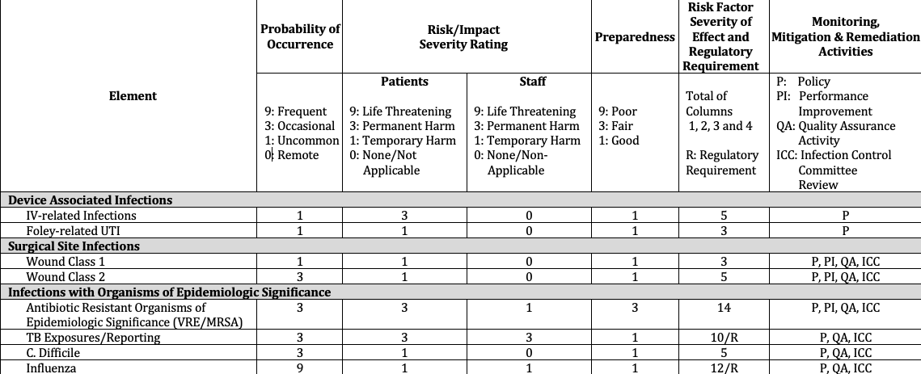
Example – ICRA
Oregon Patient Safety Committee
WWW.QUADA.ORG PATIENTS FIRST. ALWAYS.

Slide 17
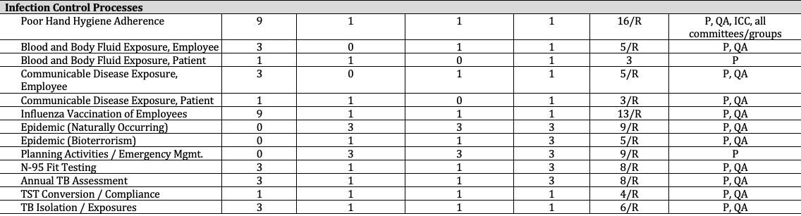
Example – ICRA
Oregon Patient Safety Committee
WWW.QUADA.ORG PATIENTS FIRST. ALWAYS.

Slide 18
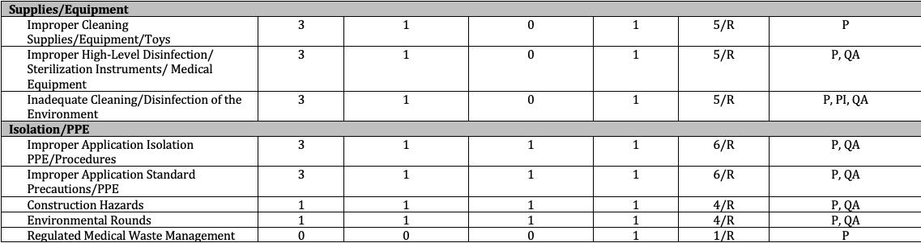
Example – ICRA
Oregon Patient Safety Committee
WWW.QUADA.ORG PATIENTS FIRST. ALWAYS.

Slide 19
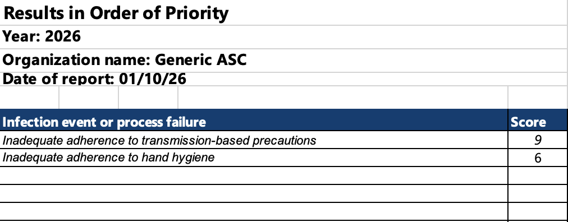
Ranking Priorities
WWW.QUADA.ORG PATIENTS FIRST. ALWAYS.

Slide 20
Goal Planning
Based on identified risks, set goals to minimize the possibility of transmitting infections:
  Reduce blood and body fluid & communicable disease exposures
  Increase hand hygiene compliance
  Eliminate the use of infections associated with the use of medical equipment, devices, and supplies
Use “SMART” objectives
WWW.QUADA.ORG PATIENTS FIRST. ALWAYS.

Slide 21
“SMART” Objectives
A framework for creating goals with clear, focused, and attainable objectives
Increase the likelihood of successful planning, implementation, and evaluation of projects or initiatives
  SPECIFIC - outline precisely what is to be achieved, leaving no room for ambiguity or confusion
  MEASURABLE - use percentages, quantities, or specific indicators to track and assess progress, allowing effective monitoring
  ACHIEVABLE - are realistic and attainable, given the constraint of resources, time, and capabilities
  RELEVANT - align with the broader purpose of the project
  TIME-BOUND - have specific deadlines attached to them
WWW.QUADA.ORG PATIENTS FIRST. ALWAYS.

Slide 22
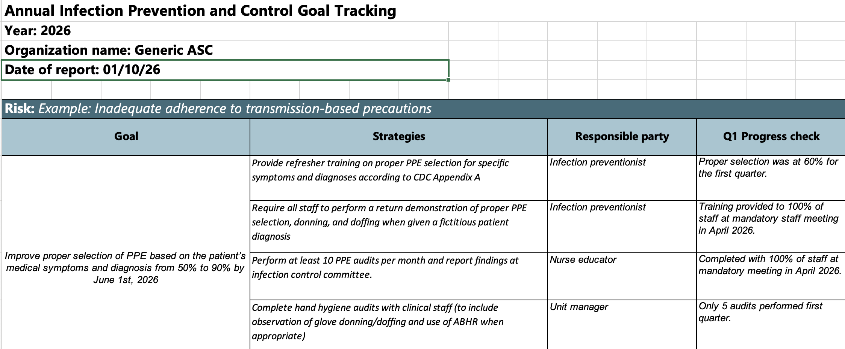
Goal Planning
WWW.QUADA.ORG PATIENTS FIRST. ALWAYS.

Slide 23
ICRA Final Thoughts
The ICRA is a living document that should change over time
  Set aside enough time and resources
  Incorporate meaningful data
  Review goal progress periodically
Review other documents ahead of time
Use IPC tools that are readily available from the CDC
Consult state DOH websites with robust resources
WWW.QUADA.ORG PATIENTS FIRST. ALWAYS.

Slide 24
RESOURCES
Oregon Ambulatory Surgery Center IPC Toolkit. https://oregonpatientsafety.org/tools-and-best-practices/oregon-asc-infection-prevention-and-control-toolkit?rq=Infection Prevention and Control
Infection Control Assessment and Response (ICAR) Tool for General Infection Prevention and Control Across Settings, CDC. https://www.cdc.gov/healthcare-associated-infections/php/toolkit/icar.html
Guidelines for Environmental Infection Control in Healthcare Facilities (2003), CDC. https://www.cdc.gov/infection-control/hcp/environmental-control/water.html
State Department of Health Websites (PA, WI, CA, KY)
Notes:
Here are links to the tools referenced in today’s presentation.

Slide 25


education@quada.org
Notes:
Thank you for your attendance during today’s webinar. Please reach out to us at Quad A via an email at education@quada.org should you have any further questions.

